Slide 1
DATA BASE MANAGEMENT SYSTEM(DBMS) ASSINGNMENT

Slide 2
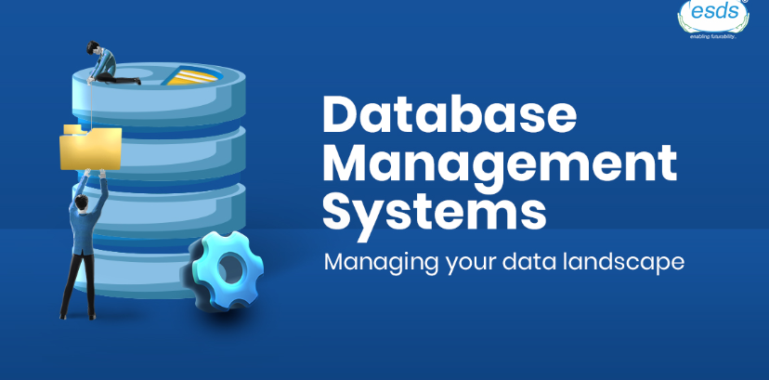
INTRODUCTION: SUBJECT:DATA BASE MANAGEMENT SYSTEM SECTION: DS-B BATCH: 22951A67B9-SAIDEEP 22951A67C0-SAMPATH

Slide 3
TASK:
9.2 …Decleration and intialisation of variables

Slide 4
SQL CODE :
-- Declare variables
DECLARE @myVariable INT;
DECLARE @anotherVariable VARCHAR(50);
-- Initialize variables
SET @myVariable = 10;
SET @anotherVariable = 'Hello';
-- Select variables to display their values
SELECT @myVariable AS MyVariable, @anotherVariable AS AnotherVariable;

Slide 5
OUTPUT:
MyVariable | AnotherVariable
--------------|----------------
10 | Hello

Slide 6
TASK:
9.3….DATA TYPES AND ITS VALUES

Slide 7
SOURCE CODE:
-- Integer data type
DECLARE @intVariable INT;
SET @intVariable = 123;
SELECT 'Integer', @intVariable AS Value;
-- Decimal data type
DECLARE @decimalVariable DECIMAL(10, 2);
SET @decimalVariable = 123.45;
SELECT 'Decimal', @decimalVariable AS Value;
-- Varchar data type
DECLARE @varcharVariable VARCHAR(50);
SET @varcharVariable = 'Hello, SQL!';
SELECT 'Varchar', @varcharVariable AS Value;

Slide 8
-- Date data type
DECLARE @dateVariable DATE;
SET @dateVariable = '2024-03-26';
SELECT 'Date', @dateVariable AS Value;
-- Boolean data type (using integer)
DECLARE @boolVariable INT;
SET @boolVariable = 1; -- 1 for true, 0 for false
SELECT 'Boolean (as Integer)', @boolVariable AS Value;
-- Boolean data type (using varchar)
DECLARE @boolVariable2 VARCHAR(5);
SET @boolVariable2 = 'True'; -- 'True' or 'False'
SELECT 'Boolean (as Varchar)', @boolVariable2 AS Value;

Slide 9
THANK YOU

